Slide 1
Process Maturity Models

Slide 2
Process and Quality
The quality of a product is largely determined by the quality of the process that is used to develop and maintain it.

Slide 3
Process Improvement Benefits
Process improvement benefits fall into eight general categories:
  improved schedule and budget predictability
  improved cycle time
  increased productivity
  improved quality (as measured by defects)
  increased customer satisfaction
  improved employee morale
  increased return on investment
  decreased cost of quality
Notes:
See notes on page 11

Slide 4
What is a CMM?
Capability Maturity Model:
A reference model of mature practices in a specified discipline, used to assess a group’s capability to perform that discipline.
CMMs differ by
  Discipline (software, systems, acquisition, etc.)
  Structure (staged versus continuous)
  How Maturity is Defined (process improvement path)
  How Capability is Defined (institutionalization)

Slide 5
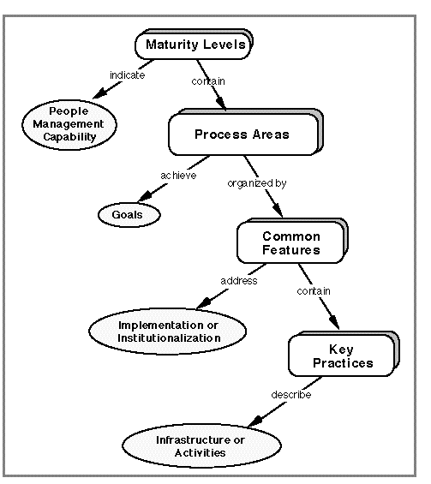
Capability Maturity Model – CMM® Structure
[CMU-SEI]

Slide 6
CMM® Structure
CMM is used as a general model to aid in improving organizational business processes in diverse areas
Each maturity level is composed of several key process areas.
A Key Process Area (KPA) identifies a cluster of related activities that, when performed collectively, achieve a set of goals.

Slide 7
Common Features
Each KPA is organized into five sections called common features.
There are five types of common features:
  Commitment to Perform,
  Ability to Perform,
  Activities Performed,
  Measurement and Analysis, and
  Verifying Implementation.
Common features include practices that implement and institutionalize a key process area.

Slide 8
The key practices
The common features specify the key practices that, when collectively addressed, accomplish the goals of each KPA.
The key practices describe the elements of infrastructure and practice that contribute most effectively to the implementation and institutionalization of the KPAs.

Slide 9
Goals
The goals of a key process area summarize the states that must exist for that key process area to have been implemented in an effective and lasting way.
The extent to which the goals have been accomplished is an indicator of how much capability the organization has established at that maturity level.
The goals signify the scope, boundaries, and intent of each key process area.

Slide 10
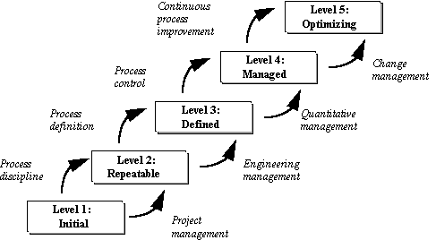
CMM Maturity Framework : Five Levels

Slide 11
CMM Maturity Framework : Five Levels
Initial (chaotic, ad hoc, individual heroics) - At this level the organization typically lacks a stable environment for developing and maintaining software. During a crisis, teams will abandon planned procedures and revert to adhoc coding and testing. Success depends entirely on the individuals, not on the process.
Repeatable - At this level, you implement processes and then you study them, repeating what works, discarding what doesn’t. This level is a project-focused tier.
Defined - At this level you’re able to define what your organization processes are and you can implement a structure to manage them.
Managed - This level is about process measurement; This stage is called managed because you’re now managing virtually every aspect of products and processes.
Optimizing - This level is called Optimizing to imply an ongoing, continuous state of operation, where entire organization is focused on continuous process improvement.

Slide 12
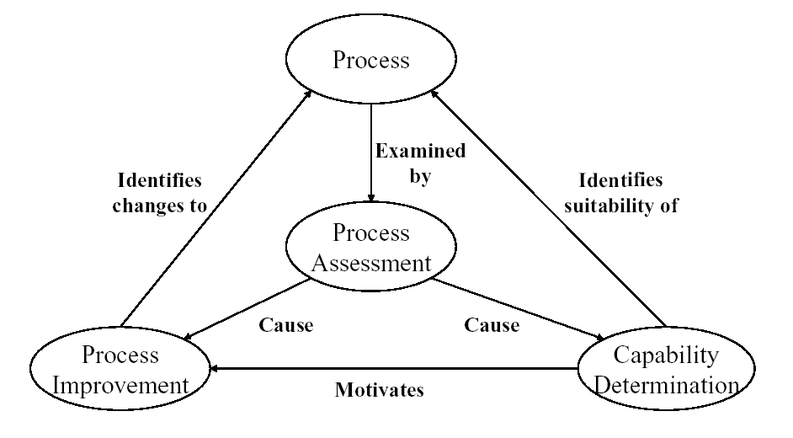
ISO 15504

Slide 13
Structure of ISO 15504
Part 1
Concepts and introductory guide
Part 9
Vocabulary
Part 7
Guide for use in
process improvement
Part 8
Guide for use in
determining supplier
process capability
Part 6
Guide to competency
of assessors
Part 3
Conducting assessments
Part 4
Guide to conducting
assessments
Part 2
A reference model for processes and process capability
Part 5
An assessment model and indicator guidance

Slide 14
